Slide 1



Health & Wellness App
Daily Habit Motivation & Health Tracking

Slide 2
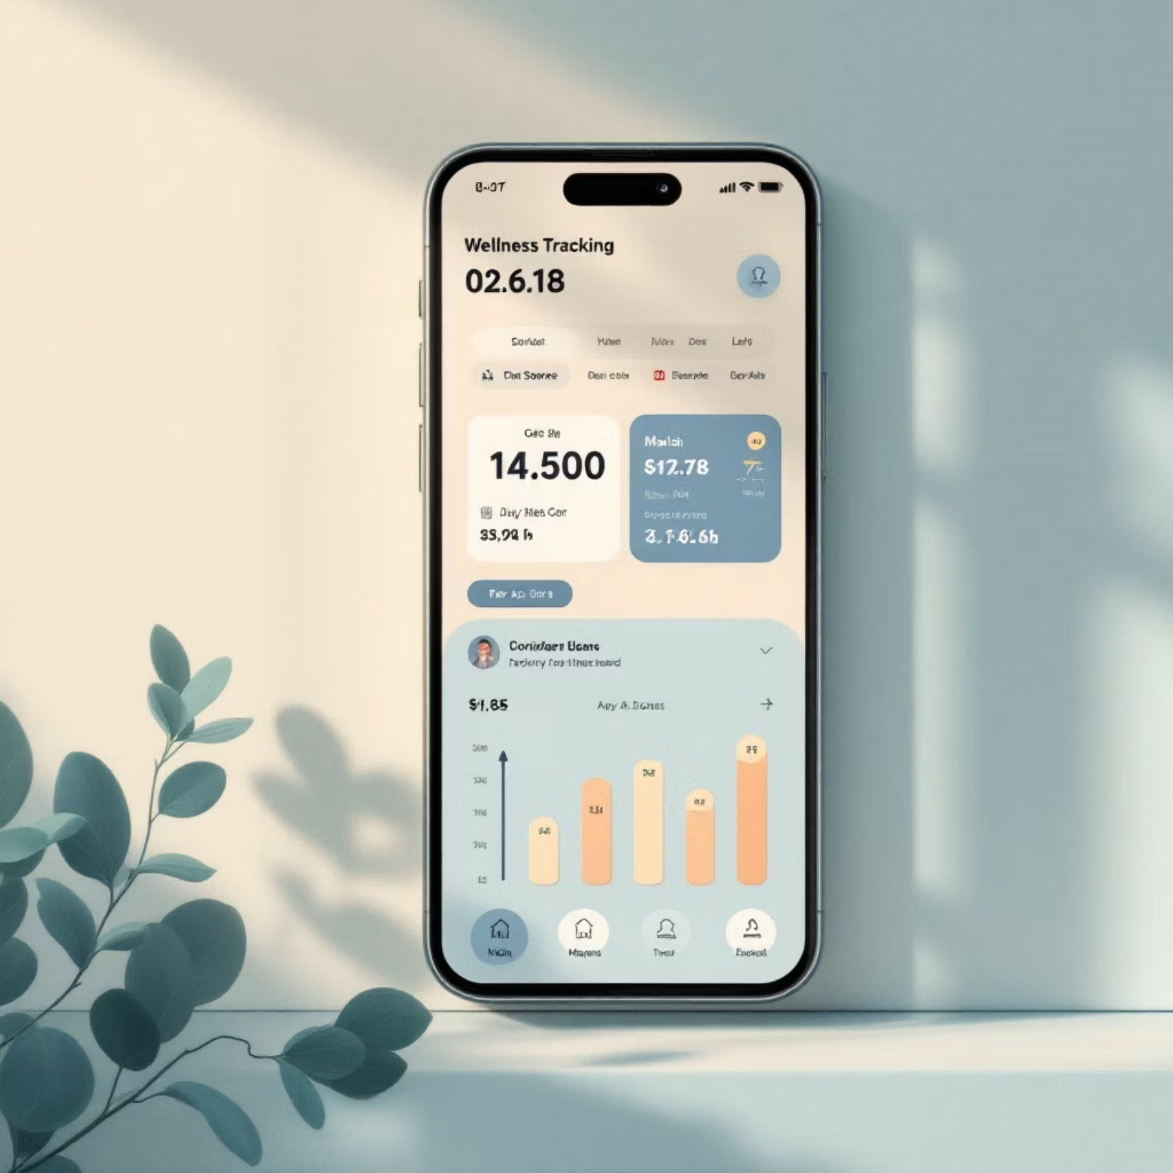




Introduction
Your Wellness Companion
This app transforms daily wellness routines into achievable, rewarding experiences through intuitive habit tracking, visual progress dashboards, and emotional support systems.
Built for busy lifestyles, it makes self-care simple, accessible, and sustainable for college students and working professionals.

Slide 3


Problem Statement
Lack of Motivation
Overwhelming Complexity
Users struggle to maintain consistency without positive reinforcement and encouragement
Current tracking apps require too many steps, discouraging daily use and habit formation
One-Size-Fits-All
Generic approaches fail to address individual needs, preferences, and accessibility requirements
Users need a solution that removes friction, celebrates progress, and adapts to their unique wellness journey.

Slide 4


User Research
Research Approach
College Student
We conducted in-depth interviews with 15 users who consistently struggled with maintaining wellness routines, seeking to understand the barriers preventing habit formation.
Balancing classes, social life, and self-care with limited time
Key Insights:
Working Professional
✅ Prefer quick, one-tap logging over complex multi-step screens
✅ Need consistent encouragement through smart notifications and visual rewards
Managing stress and wellness between demanding work schedules
✅ Want personalized recommendations based on their unique patterns
✅ Accessibility is essential—larger fonts, high contrast, and clear navigation

Slide 5

Information Architecture
01
02
03
Dashboard
Habits & Activities
Reminders & Notifications
Your personalized wellness hub displaying today's habits, progress streaks, and motivational insights at a glance
Browse, create, and customize daily wellness routines with flexible scheduling and category organization
Smart, gentle nudges that encourage consistency without feeling overwhelming or intrusive
04
05
Analytics
Profile & Goals
Visual insights showing progress patterns, completion rates, and personalized recommendations for improvement
Manage preferences, set wellness targets, and customize your experience for maximum motivation

Slide 6







User Flow & Journey
Task: Log Daily Progress
Home
Select Habit
Start from your personalized dashboard
Tap the habit you want to track
Mark Completed
Celebrate 🎉
One-tap confirmation logging
Instant positive feedback animation
Design Principle: Fewer steps equal higher motivation. The entire flow takes less than 5 seconds, removing all barriers to daily tracking and creating a delightful, rewarding experience.

Slide 7
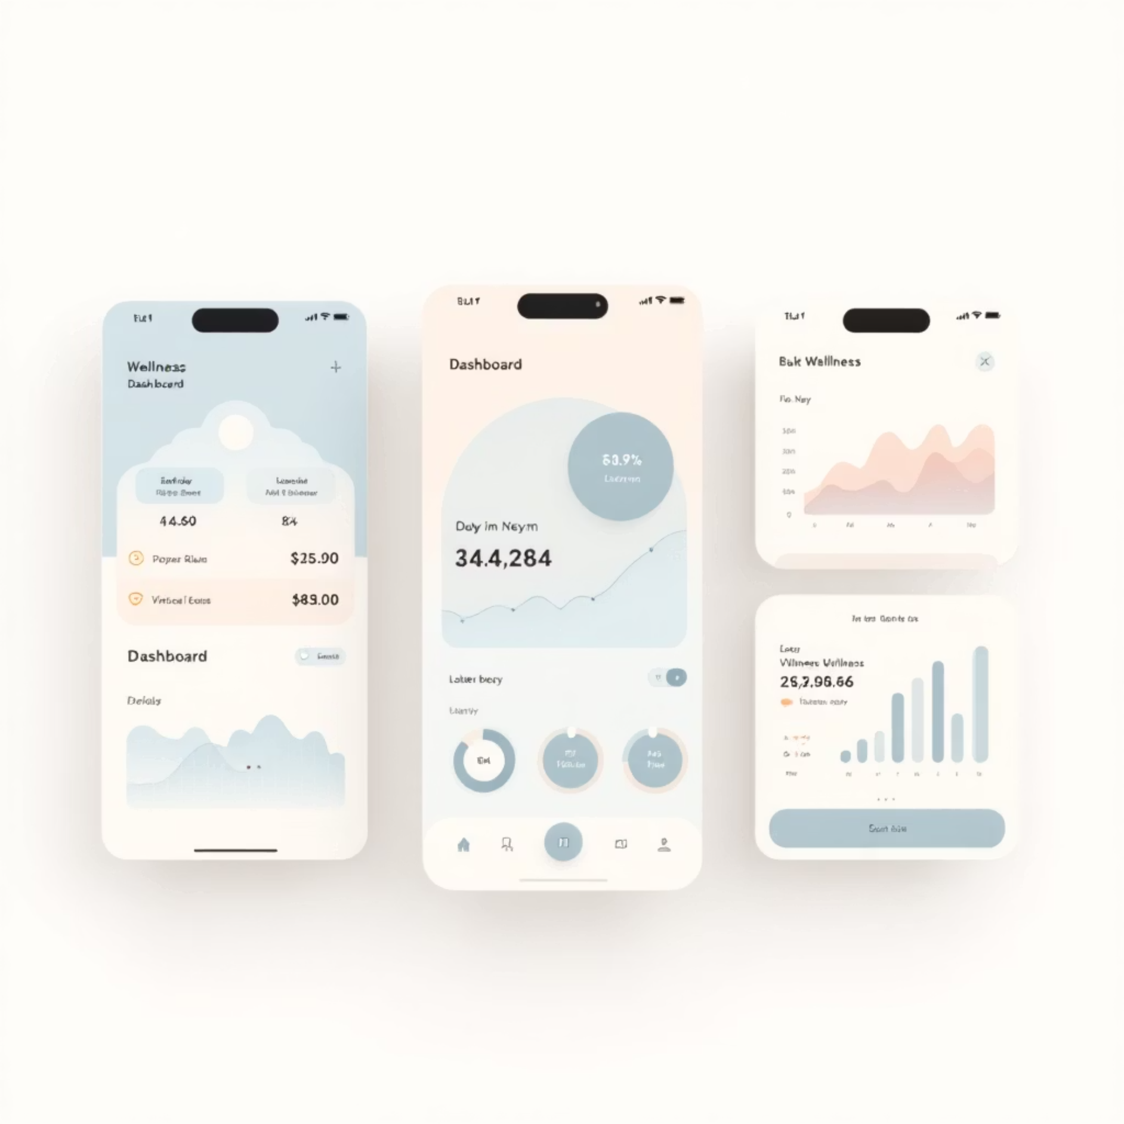

Wireframes
Low-Fidelity Explorations
We developed focused wireframes for the core user experiences, prioritizing clarity and efficiency:
Progress Dashboard — At-a-glance view of daily and weekly streaks
Habit Creation — Simple setup flow with smart defaults
Mood Check-in — Quick emotional tracking interface
Activity Page — Calendar view of completed habits
Each screen emphasizes minimal clutter for faster task completion and reduced cognitive load.

Slide 8





UI Design
Calm & Positive Theme
Pastel gradients with soft contrast create a soothing, stress-free environment that encourages daily engagement
Wellness Avatars
Friendly, customizable characters that grow and celebrate with users, building emotional connection
Motivational Streaks
Visual progress indicators with milestone celebrations that tap into intrinsic motivation
WCAG Compliant
Accessibility-first design with adjustable fonts, high contrast modes, and screen reader optimization

Slide 9

Prototype & User Testing
88%
92%
Faster Task Completion
Increased Motivation
Interactive Prototype
Users completed daily logging significantly quicker than competing apps
Positive feedback systems significantly boosted user engagement
Built in Figma with thoughtful micro-interactions:
Smooth card flip animations for habit completion
Confetti and streak effects for milestone celebrations
Accessible interactions with large tap areas and haptic feedback
Progressive disclosure to keep interfaces simple

Slide 10


Conclusion
Design Success
Key Achievements
Impact
The final design successfully encourages healthy habit formation through a simple, supportive, and accessible user experience that removes barriers and celebrates progress.
Reduced friction in daily tracking to under 5 seconds
By prioritizing user motivation and removing complexity, this wellness app empowers busy adults to build sustainable healthy habits that truly stick.
Created emotionally supportive feedback systems
Implemented comprehensive accessibility standards
Validated design through positive user testing results

